Slide 1
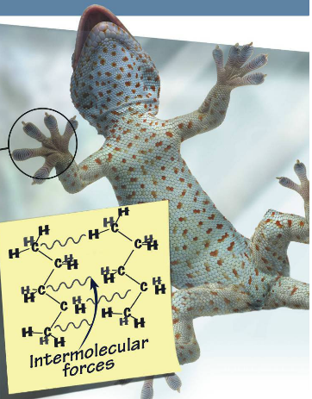
Intermolecular forces (IMF)
Ryan kiddey
University of akron ret program 2018
Lesson: That’s slick! Using polymers to clean oil spills

Slide 2
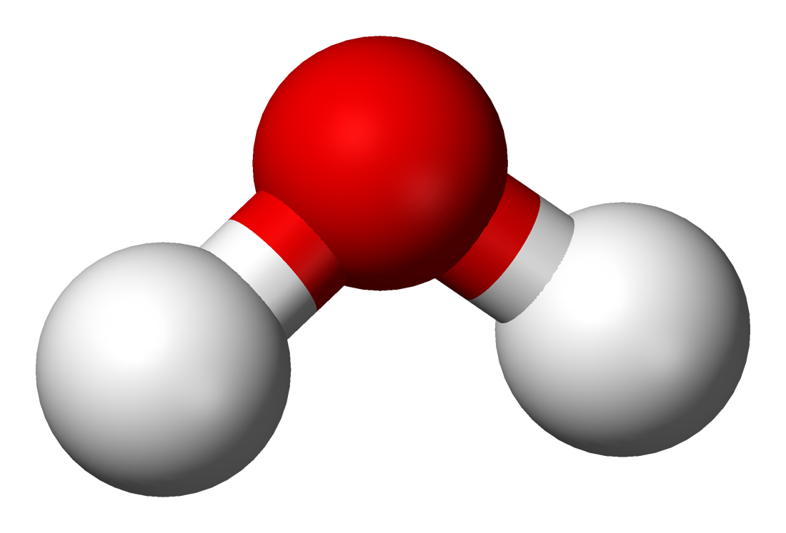
Intramolecular bond vs intermolecular force
Intramolecular bonds are chemical bonds.
Covalent
Ionic
Metallic
Think of intranet. Most businesses have an internal network that ‘bonds’ all of the computers in the building together. Outside computers cannot interact with the network of computers in the building.
Something would need to ‘connect’ the computers inside with the computers outside.

Slide 3
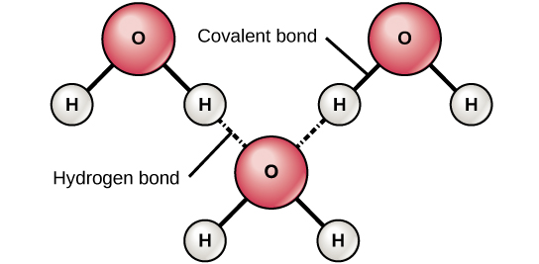
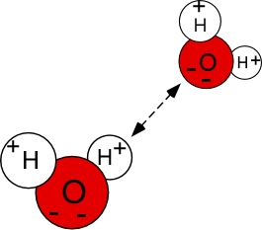
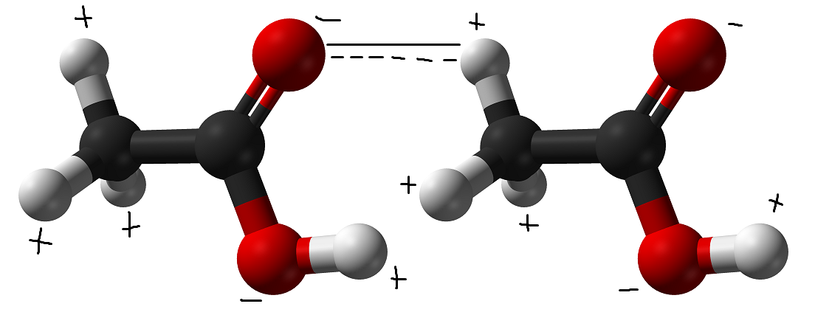
Intramolecular bond vs intermolecular force
Intermolecular force is an interaction between two molecules due to polarity
positive pole of one molecule interacting with the negative pole of another.
This is like the internet. The internet is the ‘force’ that will connect the computers on an intranet network to the outside world.
Just because you can visit the FBI’s website via the internet, it doesn’t mean you can get into their network (intranet).

Slide 4
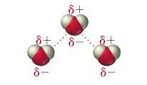
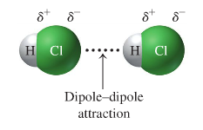
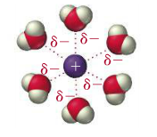
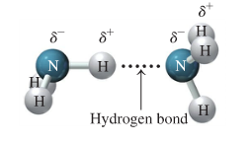
Four kinds of intermolecular forces
Intermolecular forces In the order of weakest to strongest:
dispersion force
Dipole-dipole force
Hydrogen bond
Ion-dipole force

Slide 5
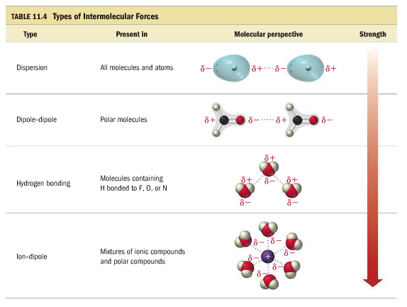
Intermolecular forces
Professor dave
Without intermolecular forces there would be no solid or liquid state to matter.
The stronger the imf the higher the boiling point… WHY?
The weaker the Imf the lower the boiling point… why?

Slide 6
What is a dipole?
Before we define each type of intermolecular force let’s define dipole.
Dipole – a molecule that has an uneven distribution of electrons across the molecule. A dipole occurs in a polar molecule.
in other words – one side of the molecule has more electrons than the other side.
Draw an example of a molecule with a dipole below:

Slide 7
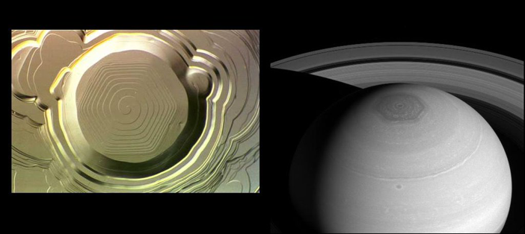
Defining each IMF: Dispersion Force
The dispersion force is also called
“London Dispersion force” or “Van Der Waals Force”
The dispersion force is the weakest of all IMFs and the force is easily broken.
However, the dispersion force can become very strong in a long molecule, even if the molecule is nonpolar.
Every monoatomic atom (helium, neon, argon, etc.) and every molecule experience the dispersion force.
The dispersion force is caused by a momentary dipole in the atom
Draw a picture of helium below:

Slide 8
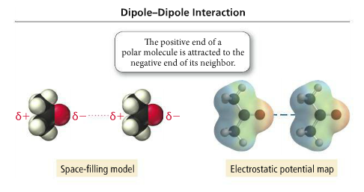
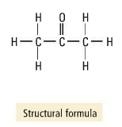
Defining each IMF: Dipole-Dipole force
Dipole-dipole force is an interaction between to polar molecules
A polar molecule has a permanent dipole
Examples:

Slide 9
Defining Each IMF: Hydrogen bond
Hydrogen bond – not a bond, not a bond, not a bond, not a bond!!!!!
The hydrogen bond is a special type of dipole-dipole force that is stronger than a normal dipole-dipole force!
The following bonds (actual bonds) create a very strong dipole
O – h
N – H
F – H
When the o, n, or f come into contact with another molecule’s hydrogen an intermolecular force will occur – called a hydrogen bond.
Water is a great example of hydrogen bonding in action!

Slide 10
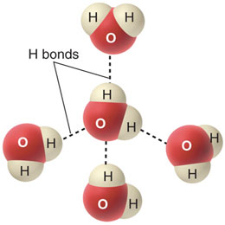
Defining Each IMF: Hydrogen Bonding
Draw a few pictures of substances hydrogen bonding:

Slide 11
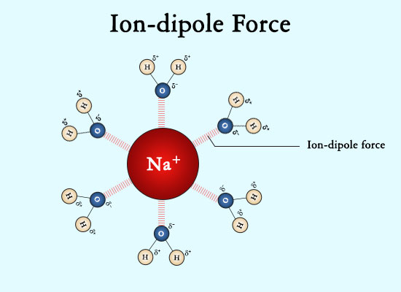
Defining Each IMF: Ion-Dipole Force
The Ion-dipole force is the strongest imf
Occurs when a polar molecule (molecule with a dipole) comes in contact with an ion.
This is why some ionic compounds will dissolve in water.
Draw a picture below:

Slide 12
references
Tro, “Chemistry: A Molecular Approach”, 3e
https://en.wikipedia.org/wiki/File:Water-3D-balls.png
https://sciencestruck.com/intermolecular-forces-with-examples
https://www.quora.com/What-is-an-intramolecular-bond
http://mbocchini.blogspot.com/2011/02/intermolecular-forces.html
https://courses.vcu.edu/PHY-rhg/astron/html/mod/018/index3.html
https://www.pinterest.com/pin/830773462482297448/
https://chemistry.stackexchange.com/questions/59665/water-hydrogen-bond/59958

