Slide 1
Biological (Organic) Molecules

Slide 2
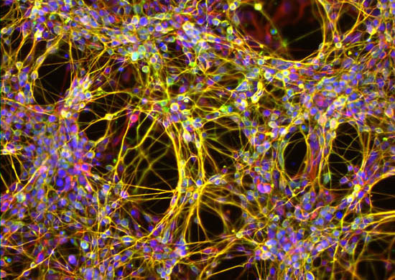
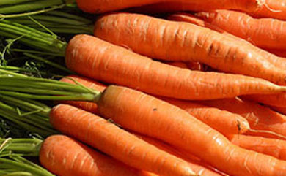
Major Components of a Cell
Carbohydrates
Proteins
Lipids
Nucleic Acids

Slide 3
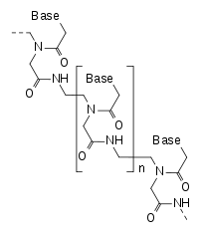
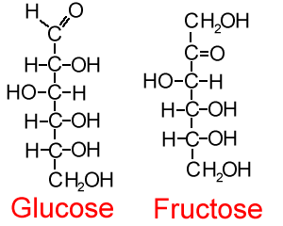
Molecules
Organic molecules: contain carbon
Water is the most abundant molecule in cells
Minerals are considered trace elements and are not needed in large amounts to sustain life

Slide 4
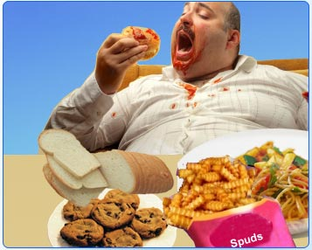
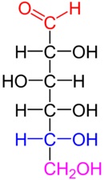
Carbohydrates
Provide energy to cells
Consist of atoms of carbon, hydrogen and oxygen
Usually twice as many hydrogen as oxygen atoms
C₆H₁₂O₆ glucose
C₁₂H₂₂O₁₁ sucrose
Simple sugars: monosaccharides
Complex carbohydrates: disaccharides or polysaccharides

Slide 5
Carbohydrates
Stimulate the immune system
Play a role in binding viruses and bacterial pathogens
Provide cell structure

Slide 6
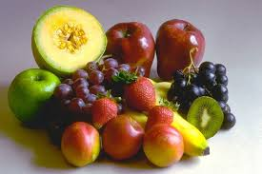
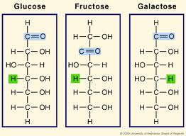
Monosaccharide
Simple sugars
Easily broken down for energy

Slide 7
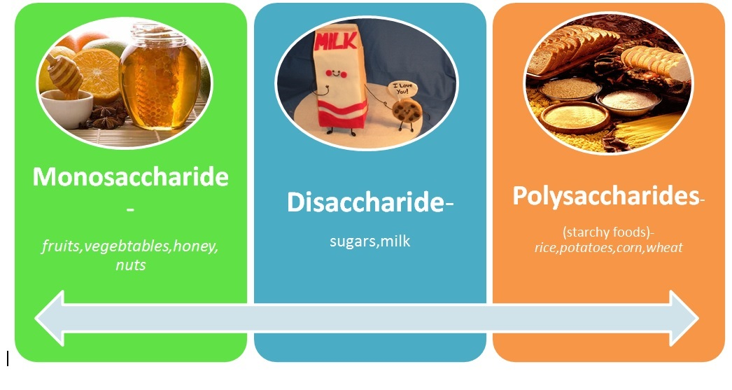
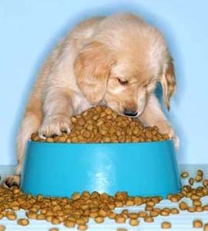
Polysaccharides
Complex sugars
Examples: starch, glycogen, cellulose
Used for energy storage and to build cell structures
Broken down through cellular respiration to create energy (ATP)

Slide 8
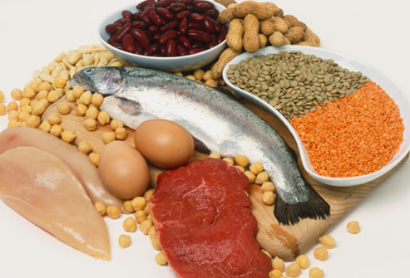
Proteins
Serve as structural materials, energy sources or hormones
Combined with carbohydrates and function on cell surface as receptors
Contain Carbon, hydrogen, oxygen and nitrogen. Sometimes they also contain sulfur atoms
Building blocks are amino acids

Slide 9
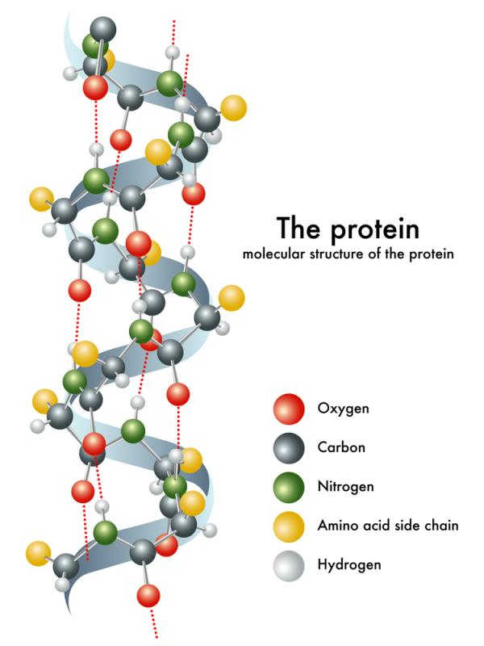
Proteins
Serve as Transport molecules such as hemoglobin carrying oxygen in rbc.
Stimulate nerve impulses
Provide immune protection

Slide 10
Protein Categories
Build Cell Structure
Transport molecules between cells
Relay messages – hormones
Speed up reactions – enzymes

Slide 11
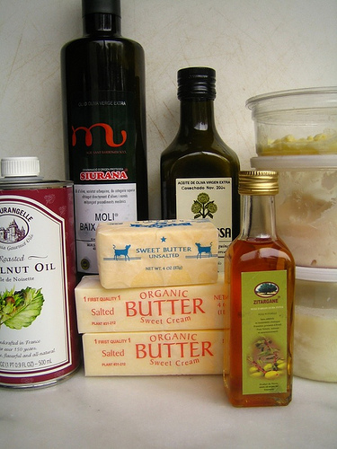
Lipids
Organic substances which are insoluble in water
Soluble in certain organic solvents such as ether or acetone
Include fats, phospholipids and steroids
Store energy for cells and can store more energy, gram for gram, than carbs
Building blocks for fats are fatty acids and glycerol.

Slide 12
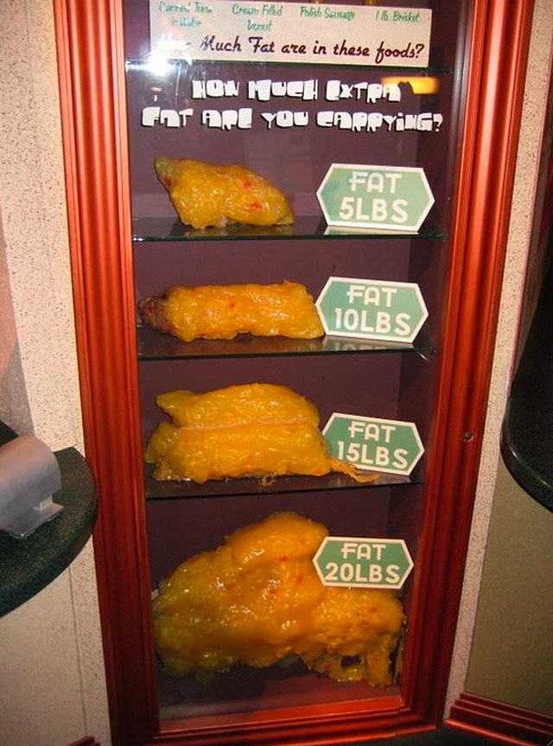
Lipids
Lipids are highly useful storage molecules, can be broken down to release more energy than a sugar molecule

Slide 13
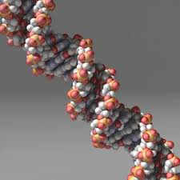
Nucleic Acids
Contain carbon, hydrogen, oxygen, nitrogen and phosphorus.
Building blocks are nucleotides
2 types of nucleic acids:
RNA: contain ribose
DNA: Deoxyribose
Store and transfer genetic information
Control cellular activities

Slide 14
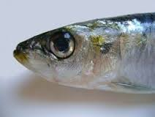
Nucleic Acids
Provide instruction for making proteins which direct the structure and activity of the cell
Ex. RNA, DNA, NAD
DNA is the most important of these molecules because it makes the organism what it is

Slide 15
4 Classes of Biological molecules
Biological molecule | Repeating subunit
Proteins | Amino acids
Carbohydrates | Simple sugars
Nucleic Acid | Nucleotides
Lipids | No single repeating unit exists. Primarily hydrocarbons, which are chains of carbon molecules linked to hydrogens

